Slide 1
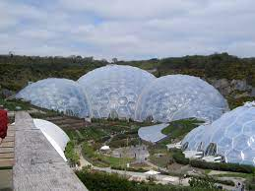
Dome city
Ayanna Silvers

Slide 2
Overview
Buckminster Fuller
1960
Plan and implementation

Slide 3
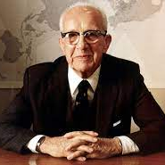
Buckminster Fuller
Created idea of dome cities
Born July 12, 1895, in Massachusetts
A practical philosopher
Notes:
On July 12, 1895, a visionary and inventor named Buckminster Fuller was born in Milton, Massachusetts. Fuller was a practical philosopher who dedicated his life to making the world work for everyone.

Slide 4
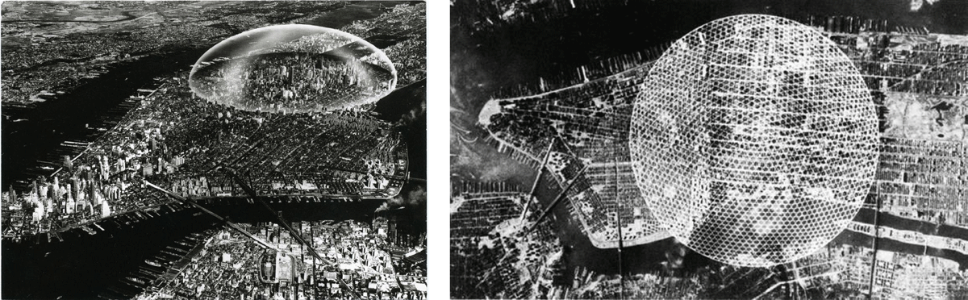
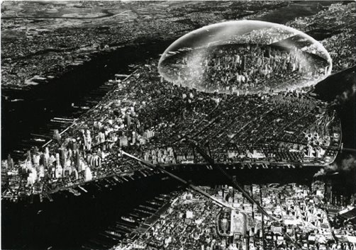

1960
In 1960 the idea was first created
Suggested by Shoji Sadao
3km wide and 1.6 high
Encompass Manhattan
​
Notes:
In 1960, engineer Richard Buckminster Fuller and architect Shoji Sadao suggested a 3 km wide and 1.6 km high dome encompassing Midtown Manhattan, featured in one of the earliest designs for a true domed city.

Slide 5
Plan and Implementation
Over $150 billion
Population no more than 500,000
Controlled environment
Loss and gain of jobs
No cars and under ground trains to transport in an out of dome cities
Notes:
The cost of the dome city would be over 150 billions dollars with a population that would be no more than 500,000 which means there will no longer be any Mega Cities such as New York and Mexico City. The environment will be fully controlled for example the weather would most likely stay a 71 degrees and be scheduled to rain at a certain time every day which leads to no longer needing jobs that help predict the weather and that won't be the only job that is lost however agricultural studies jobs will be needed lots more creating new jobs. In the dome city there will no longer be a need for cars since everything is at a walking, biking, or scootering distance. To get in and out of the dome city you will use underground train systems.

